Slide 1

Custom IDA Sidharth Bansal Employee Id : 655314

Slide 2
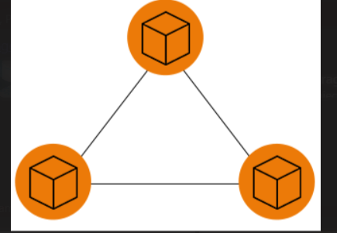
Day 1 4th September
Types of Storages file,object and block
Different access tier of blob storage hot,cool,cold,archive tier
Azure storage vs Cosmos DB
Hands on Azure Storage and created containers
Hosted Static website

Slide 3
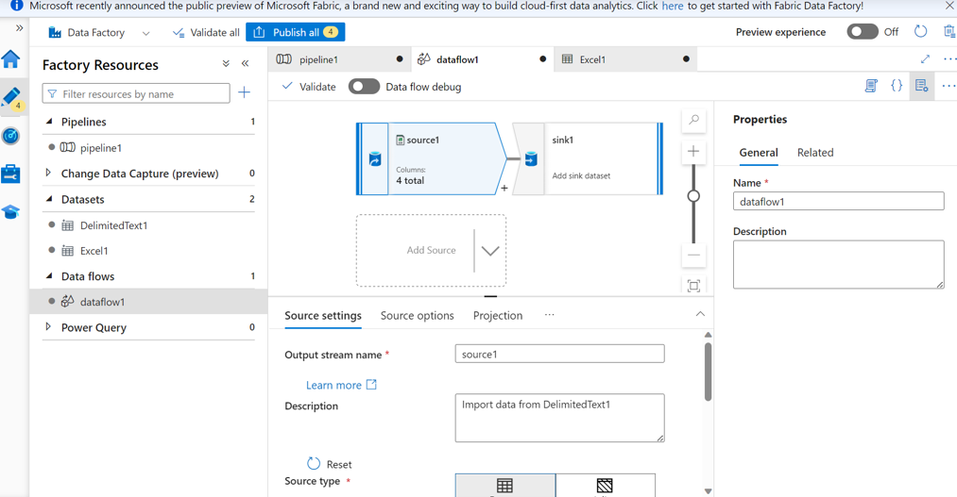
Day 2 5th September
Introduction to LRS,ZRS,GRS and GZRS
Learned about Access Keys and Shared Access Signatures
Hands on data factory creation
Created a basic data pipeline

Slide 4
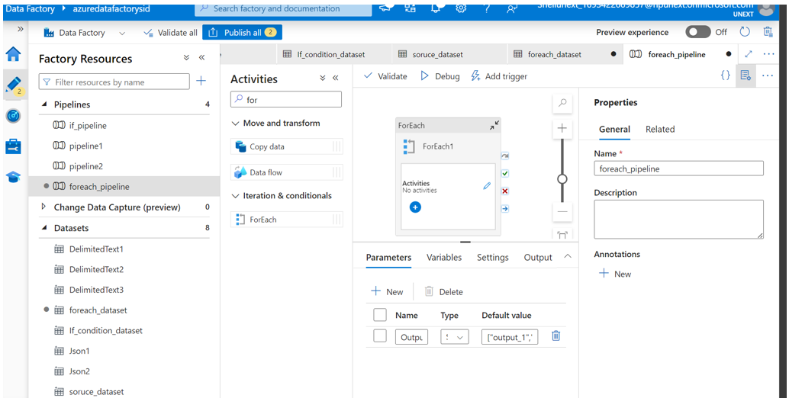
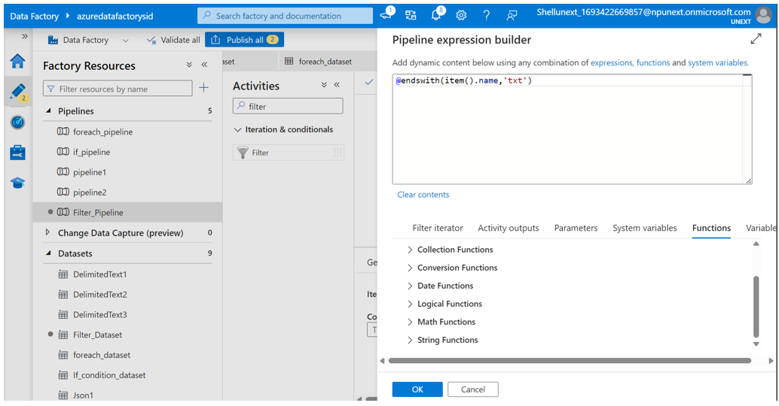
Day 3 6th September
Hands on data pipeline creation for practicing different activities like if else,for each,filter,until,copy data
Learned how to use parameters

Slide 5
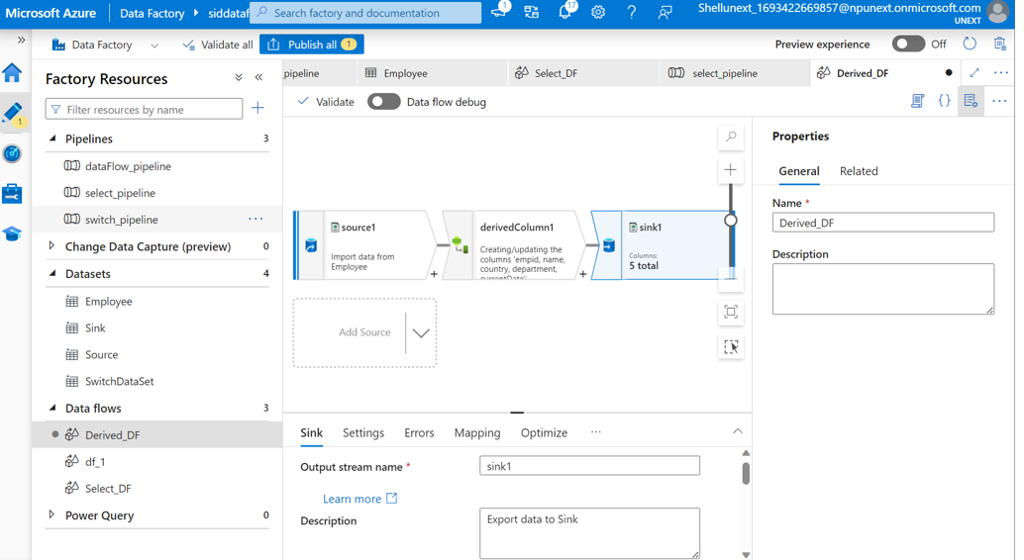
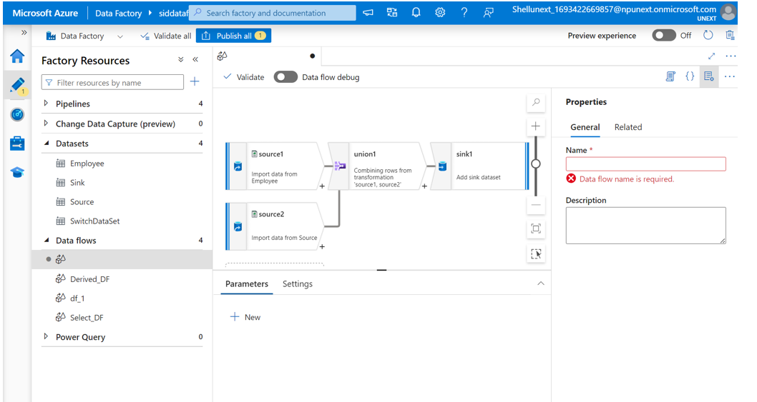
Day 4 7th September
Hands on with switch activity
Created basic dataflow
Used select,filter,derived column,union,sort and conditional split while creating data flow

Slide 6
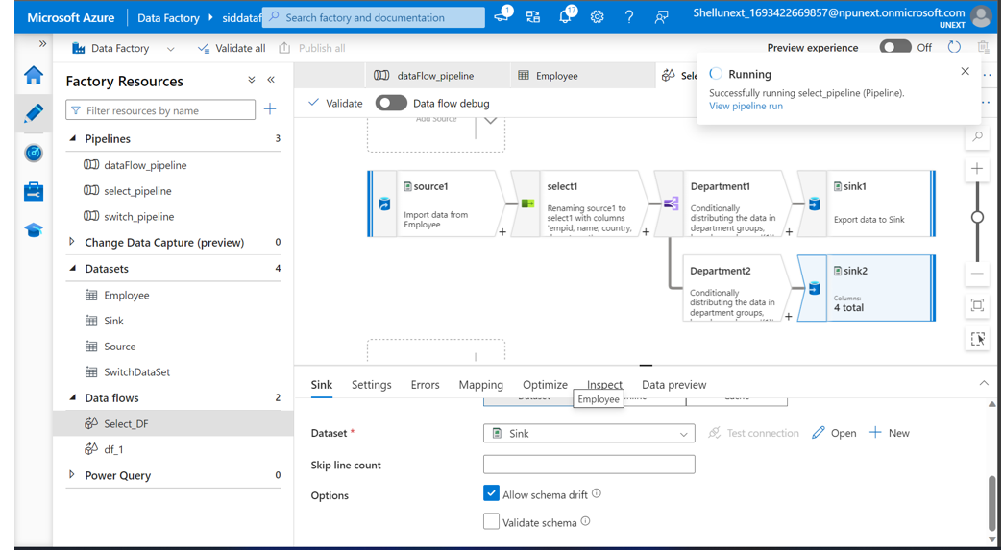

Slide 7
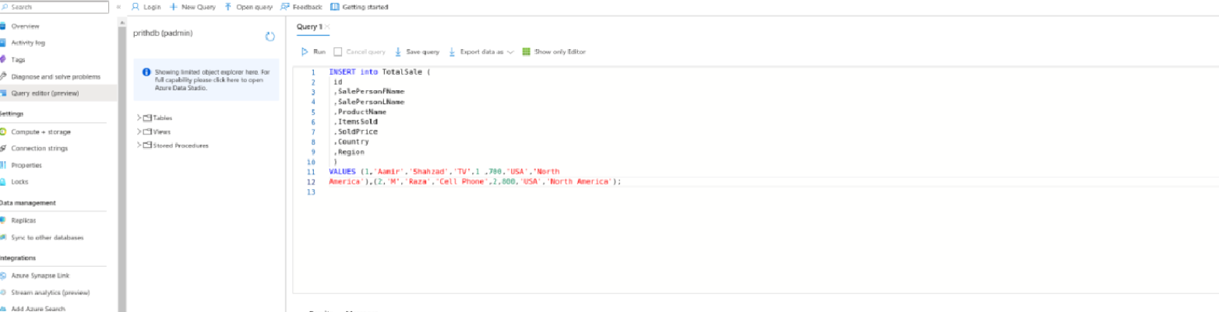
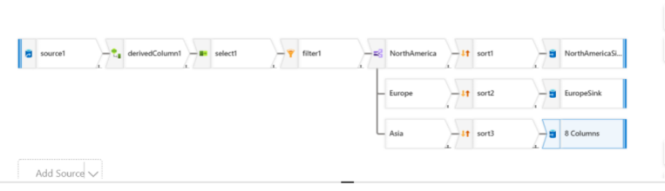
Day 5 8th September
Case study in a group
Created Azure Sql database and server
Made a dataflow pipeline to convert sql table to csv
Used select,conditional split,derived column in the dataflow

